Slide 1
A Comparative Analysis of Microplastics Consumed by White Perch in Two Locations Along The Hudson River, USA.
Emily Kucharczyk

Slide 2
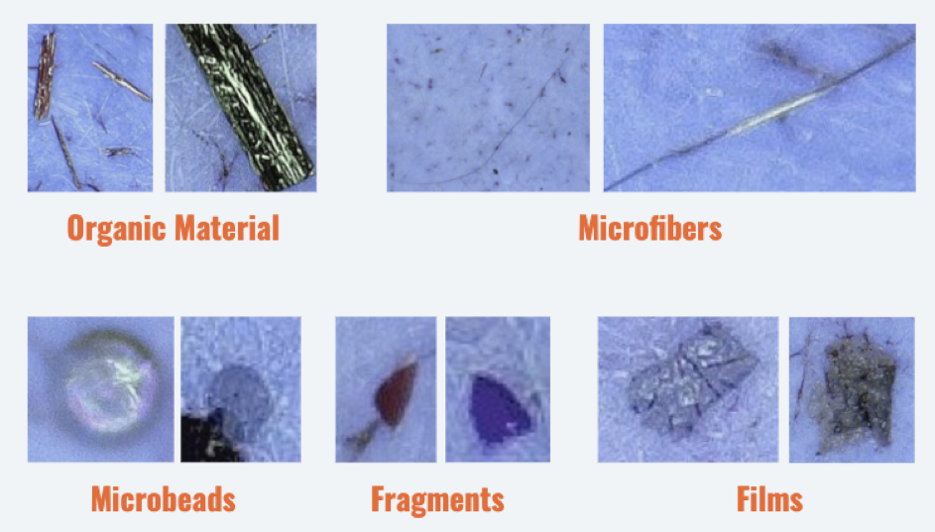
Introduction
Plastic is susceptible to degradation and weathering
Microplastics: pieces of plastic <5mm
Classified as primary and secondary
Characterized by shape, size, weight, and polymer type
17, G., & Blogger, G. (2020, June 17). Sustainability science Capstone Workshop INVESTIGATES microplastics in the Hudson River. Retrieved February 03, 2021, from https://blogs.ei.columbia.edu/2020/06/17/sustainability-science-capstone-workshop/

Slide 3
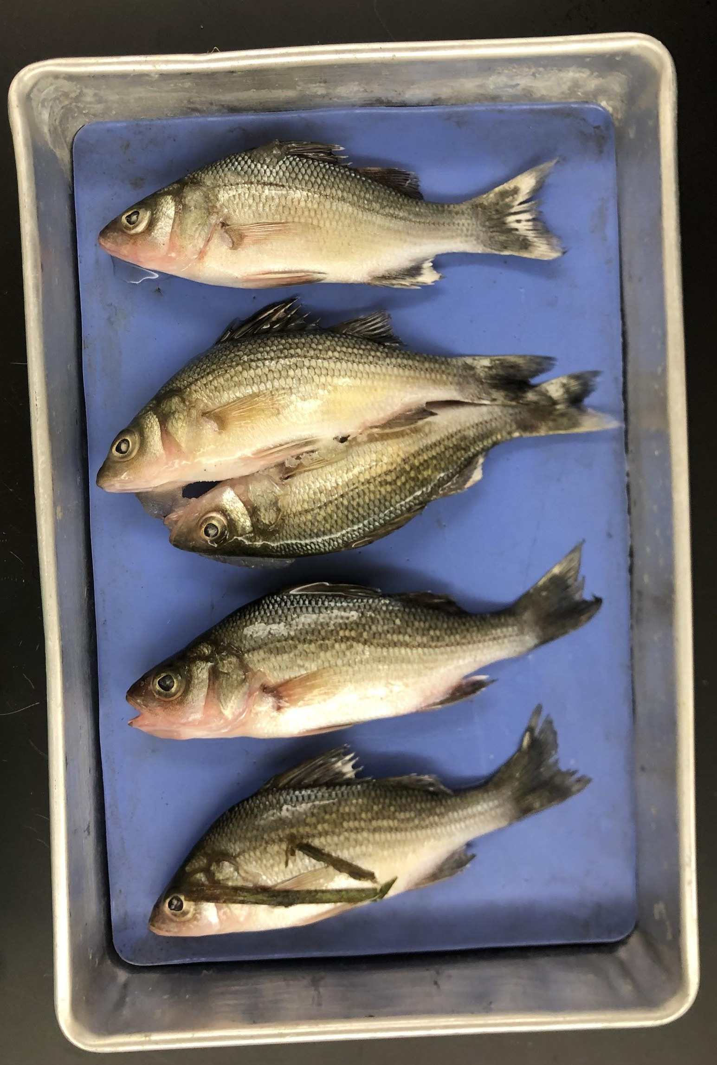
Introduction
Microplastics are bioavailable to white perch
Ingested plastic can have adverse effects on fish
Rivers serve as a major pathway for plastic transport
Resident throughout the 243 km tidal portion of the Hudson River
Locations differ in population density, industry and land use patterns

Slide 4
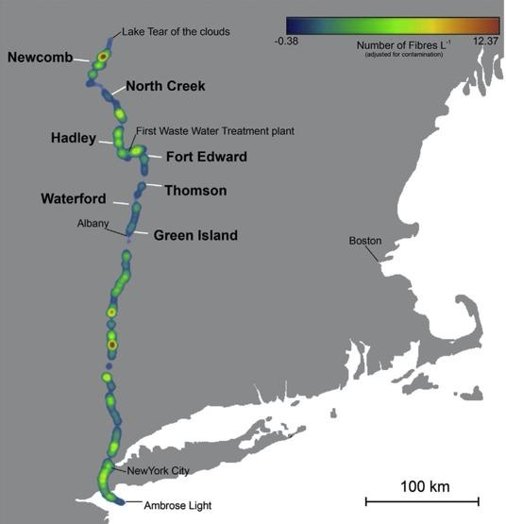
Review of Literature
Microfiber pollution in the Hudson River does not have a north to south linear increase
Miller, Rachael & Watts, Andrew & Winslow, Brooke & Galloway, Tamara & Barrows, Abigail. (2017). Mountains to the sea: River study of plastic and non-plastic microfiber pollution in the northeast USA. Marine Pollution Bulletin. 124. 10.1016/j.marpolbul.2017.07.028.

Slide 5
Review of Literature
An average of 13 billion microplastic particles are being released into US waterways/day via municipal wastewater.
Mason, S. A., Garneau, D., Sutton, R., Chu, Y., Ehmann, K., Barnes, J., ... & Rogers, D. L. (2016). Microplastic pollution is widely detected in US municipal wastewater treatment plant effluent. Environmental Pollution, 218, 1045-1054.
Notes:
Potential pathways for the transport of microplastics and its biological interactions.

Slide 6
Review of Literature
Plastic debris is considered to be resistant to wet peroxide oxidation (WPO) processing
Masura, J., et al. 2015. Laboratory methods for the analysis of microplastics in the marine environment: recommendations for quantifying synthetic particles in waters and sediments. NOAA Technical Memorandum NOS-OR&R-48.

Slide 7
Hypothesis
Higher microplastic contamination will be measured in White Perch sampled in Poughkeepsie than in South Coxsackie.

Slide 8
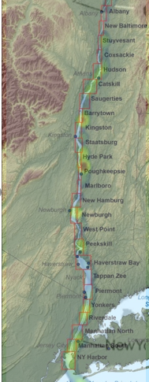
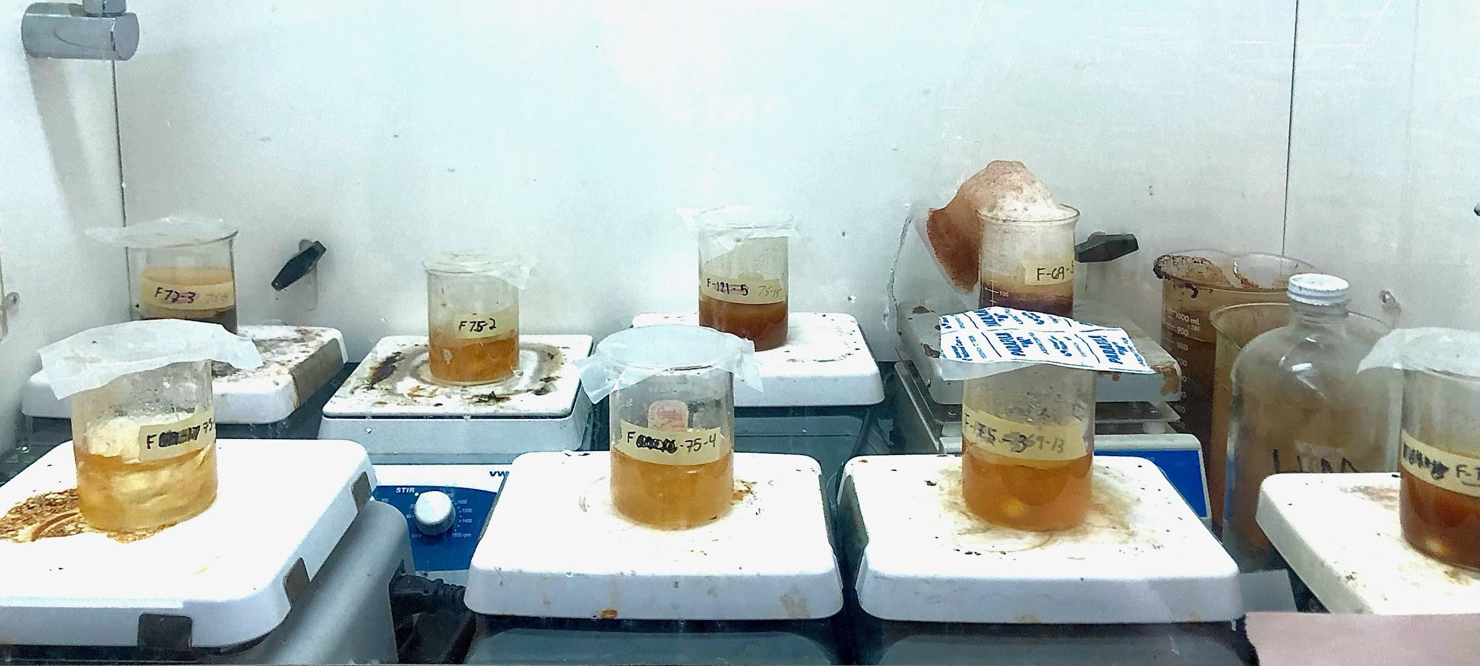
Methodology
New York Department of Environmental Conservation (DEC)
Sample sites in Poughkeepsie and Coxsackie
Varying population densities, urbanization, and WWTPs
Wet peroxide oxidation digestion method
Size-separation and characterization
Notes:
Trailheads and other smaller plastic inputs?

Slide 9
Results
Plastic found in 35 (81%) of 43 fish.
Of the 129 size-separated samples, 56 samples (43%) contained particulate.
# of particles | 59 (50%) | 57 (49%) | 1 (1%) | 0 (0%) | 0 (0%) | 117
Type | Fragment | Fibers | Film | Bead | Foam | Total

Slide 10
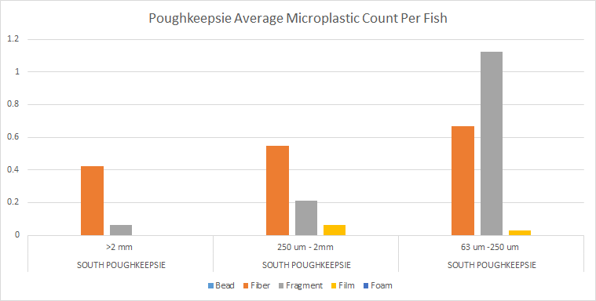
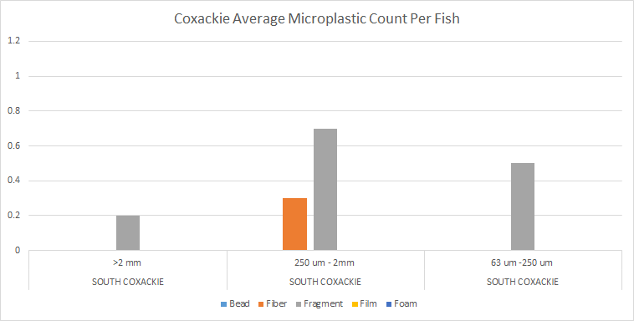
Results
Size-specific average particulate abundance for Poughkeepsie
Size-specific average particulate abundance for Coxsackie

Slide 11
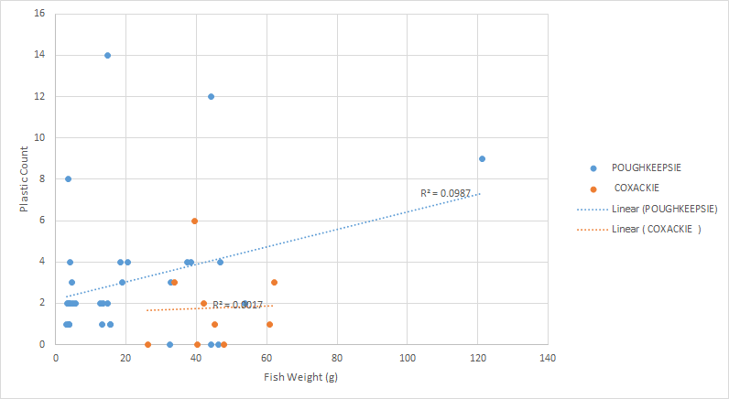
Results
Particulate abundance as a function of fish weight (g)
Poughkeepsie: r²=0.0987, Coxsackie: r²=0.0017
Notes:
stronger linear relationship between fish size and plastic count in Poughkeepsie than in Coxsackie

Slide 12
Discussion
Poughkeepsie contained 2.3 times more microfibers than those sampled from Coxsackie
Similar to background river contamination
Poughkeepsie has 2 times the number of WWTPs and fish-ingested fibers
Fewer sources for contamination in Coxsackie
Frequency of fragments was not significantly different across the two locations
Bigger fish in Poughkeepsie may be consuming more plastics
Results should be evaluated with consideration
Notes:
Discharge of microfibers per liter of water varies in concentration, densities, and discharge points

Slide 13
Conclusion
Higher microfiber contamination was measured in White Perch sampled in Poughkeepsie than in South Coxsackie.
Aquatic species are at risk of uptake and calls for regulations
Potential Future Research:
Source of fiber vs fragments
Impact of fish migration on plastic ingestion.
Notes:
So yes, the results were consistent with expectations- there was a higher microfiber count found in fish sampled from poughkeepsie than in fish from coxsackie
However these findings have to be evaluated with the consideration that there was no way to confirm particle composition due to lab restrictions and that there is little to no research done on concentrations of plastic fragments along the hudson
Although few studies have been done to examine the long-term effects of ingesting plastics, they are known to have toxic properties and can have adverse effects on any wildlife that consume them
The high frequency of particles found per fish in this study suggests that many aquatic species are at risk of uptake and calls for regulations that will reduce the danger that the pollutants pose on aquatic ecosystems. Reducing the amount of plastic we produce as a society and improving upon ways to dispose of it can help eliminate the amount found in the environment by stopping it from the source.
Awareness of the unnecessary use and disposal of plastic and its negative effects on the environment could collectively improve ecosystem health.

Slide 14
Acknowledgements
NY Department of Environmental Conservation
Mr. Seweryn
Dr. Danielle Garneau
Science research peers
My parents

Slide 15
References
[1] & Klaine,13(3),31pp. (NOAA Technical Memorandum NOS-OR&R-48). DOI: http://dx.doi.org/10.25607/OBP-604
[2]Remy,347(6223),505–509. doi:10.1002/ieam.1907
[3]Sustainability Science Capstone Workshop Investigates Microplastics in the Hudson River. (2020,75–116.Rochman,768–771. doi:10.1126/science.1260352
[4]Dris,A.,Abigail. (2017). Mountains to the sea: River study of plastic and non-plastic microfiber pollution in the northeast USA. Marine Pollution Bulletin. 124. 10.1016/j.marpolbul.2017.07.028.
[5]U.S. Census Bureau,Andrady,Andrew & Winslow,Arnold. (2016). Transport and Fate of Microplastic Particles in Wastewater Treatment Plants. Water Research. 91. 10.1016/j.watres.2016.01.002.
[6]Markich,Bernard & Compère,Brooke & Galloway,Bruno. (2016). Synthetic fibers in atmospheric fallout: A source of microplastics in the environment?. Marine Pollution Bulletin. 104. 10.1016/j.marpolbul.2016.01.006.
[7]Phillips,C.,C. M.,Chelsea & Hoh,Colin. (2011). Occurrence and distribution of microplastics in marine sediments along the Belgian coast. Marine pollution bulletin. 62. 2199-204. 10.1016/j.marpolbul.2011.06.030.
[8]Au,Cécile & Tassin,Daniel & Rogers,Danielle & Sutton,Darrin. (2016). Microplastic pollution is widely detected in US municipal wastewater treatment plant effluent. Environmental pollution (Barking,E. L. B.,Essex : 1987). 218. 10.1016/j.envpol.2016.08.056.
[9]Masura,Eunha & Kurobe,France & Gilbert,François & Collard,Gauthier & Lepoint,Geyer,Gilles. (2015). When Microplastic Is Not Plastic: The Ingestion of Artificial Cellulose Fibers by Macrofauna Living in Seagrass Macrophytodetritus. Journal of Environmental Science and Technology.
[10]Carr,Graeme & Apte,J.,J. A. (2015). “Deleterious effects of litter on marine life.” in Marine Anthropogenic Litter,J. E.,J. R.,Jambeck,James & Schmidt,Jason & Fink,Jenifer & Woodbury,Jenny. (2001). Incorporating metal speciation and bioavailability into water quality guidelines for protecting aquatic ecosystems. Australasian Journal of Ecotoxicology. 7. 109-122.,Jin & Tesoro,Johnny & Saad,June 17). State of the Planet. https://blogs.ei.columbia.edu/2020/06/17/ sustainability-science-capstone-workshop/

Slide 16
References
[11]Miller,K. L. (2015). Plastic waste inputs from land into the ocean. Science,Karen & Janssen,Karyn & Barnes,L. Gutow,Lee,Lieve & Clerck,M.,MD,Melissa & Bonner,Michiel & De Meester,Mohammed & Mirande-Bret,NOAA Marine Debris Division,NY: Springer International Publishing),P.,Parker & Papazissimos,Paul & Batley,Perryman,Peter. (2015). Current and Potential Methane Production for Electricity and Heat from New York State Wastewater Treatment Plants..
[12]Trophic transfer of microplastics in Phalacrocorax auritus (Double-Crested Cormorants) and fish in Lake Champlain
[13]Kühn,Philippe & Eppe,Population Estimates Program (PEP),R.,Rachael & Watts,Rachid & Gasperi,Rebecca & Chu,Rebolledo,Robert & Dey,Ronald & McLaren,S.,S. J. (2017). Trophic transfer of microplastics in aquatic ecosystems: Identifying critical research needs. Integrated Environmental Assessment and Management,S. Y.,Scott & Brown,Sherri & Garneau,Siegler,Simon & Stauber,Steve & Liu,Steven & Landuyt,Swee. (2013). Ingested plastic transfers hazardous chemicals to fish and induces hepatic stress. Scientific reports. 3. 3263. 10.1038/srep03263.
[14]Klauda,T. R.,Tamara & Barrows,Timothy. (2015). Occurrence and amount of microplastic ingested by fishes in watersheds of the Gulf of Mexico. Marine pollution bulletin. 100. 10.1016/j.marpolbul.2015.08.041.
[15]Wright, S. L., Thompson, R. C., & Galloway, T. S. (2013). The physical impacts of microplastics on marine organisms: A review. Environmental Pollution, 178, 483–492. doi:10.1016/j.envpol.2013.02.031
[16]Wightman,Tomofumi & Teh,W.. (1988). Life History of White Perch in the Hudson River Estuary.
[17]Wightman, Jenifer & Woodbury, Peter. (2015). Current and Potential Methane Production for Electricity and Heat from New York State Wastewater Treatment Plants..
[18]Claessens,Weinstein,Wilcox,Yvonne & Ehmann,and M. Klages (New York,and Van Franeker,eds. M. Bergmann,et al. (2015) Laboratory methods for the analysis of microplastics in the
marine environment: recommendations for quantifying synthetic particles in waters
and sediments. Siver Spring,updated annually. Population and Housing Unit Estimates Mason,van den Hurk,… Law

